Slide 1
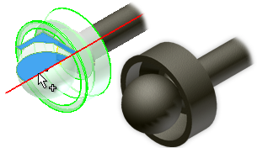
3D CAD

Slide 2
Learning Intentions
3D Modelling- Extrude, Revolve, Fillet Etc.
3D Modelling- Advantages
Animation & Simulation- Advantages

Slide 3
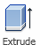
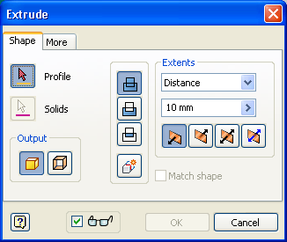
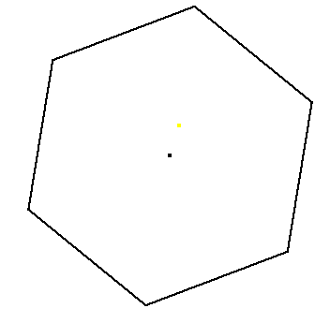
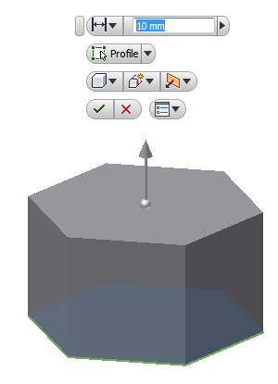
3D Modelling- Extrude
Extrude
Join: Adds the volume created by the extruded feature to another feature or body.
The extrusion tool is used to add depth to a sketch to transform it into a 3D model as shown below
Cut: Removes the volume created by the extruded feature from another feature or body.

Slide 4
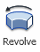
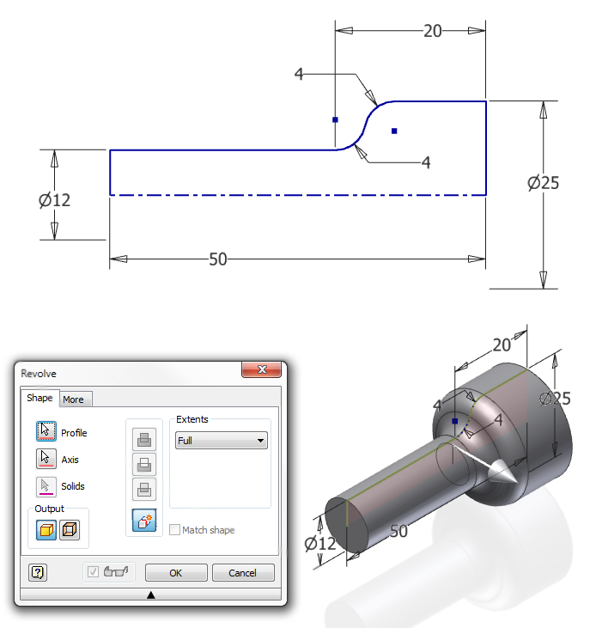
3D Modelling- Revolve
Revolve
Revolve
Creates a 3d model or feature by revolving a profile around an axis.
Profile is the sketch
Axis is the centre line you want to revolve round

Slide 5
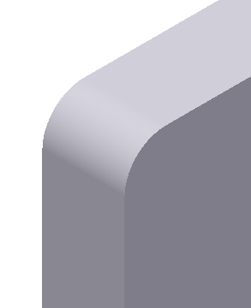

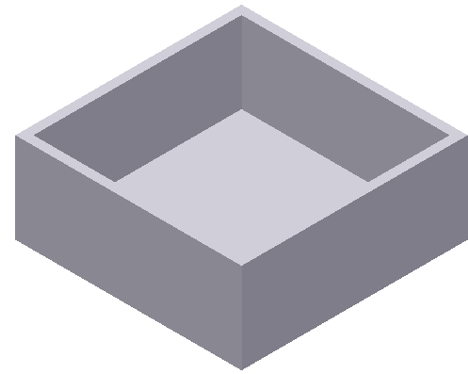
3D Modelling- Alterations
Shell
Fillet
Chamfer
The shell tool allows you to remove surfaces and hollow out any shape or feature.
The fillet tool allows you to round any selected corner or edge on a model.
The chamfer tool allows you to remove an angular section along any selected corner or edge.

Slide 6
3D Modelling- Advantages
Models can be easily sent electronically all over the world
Components can be used in different projects
Ease of modification- can be changed easily
Ease of storage- as opposed to large scale models

Slide 7
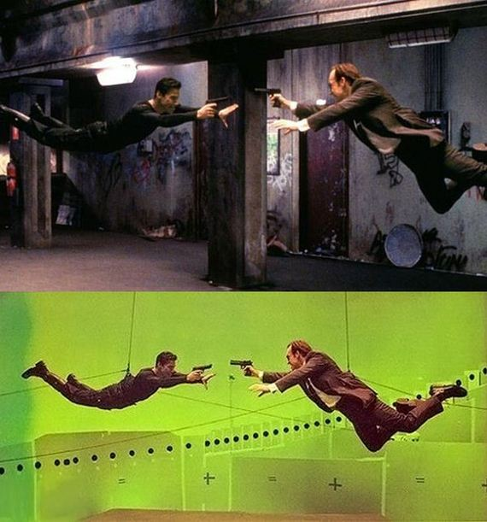
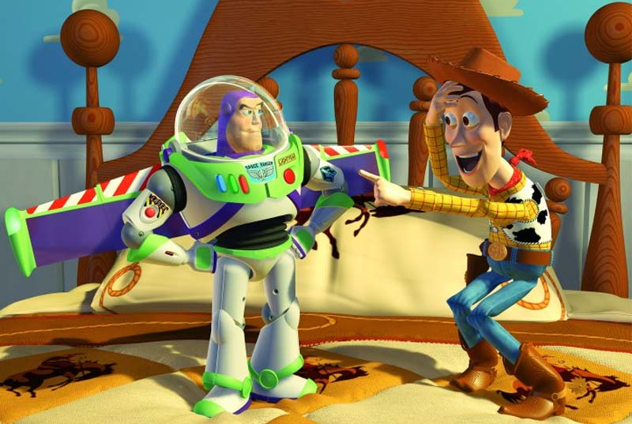
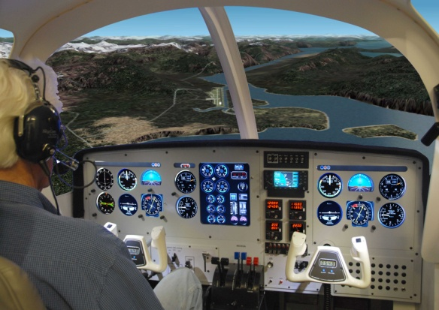
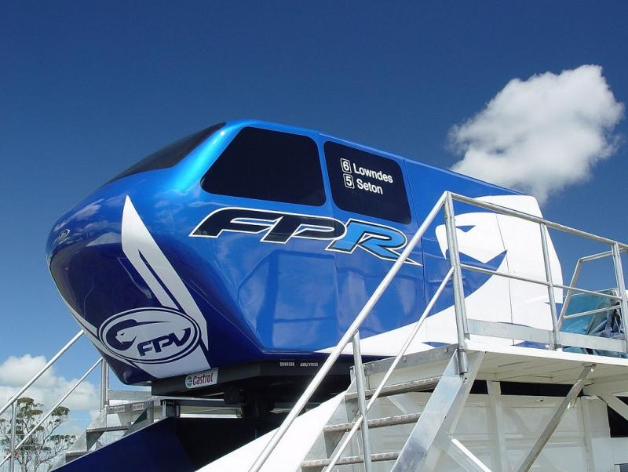
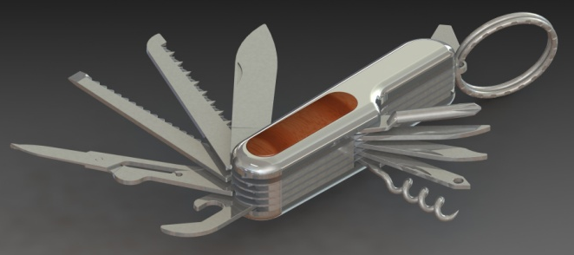
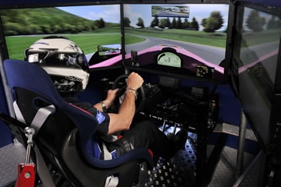
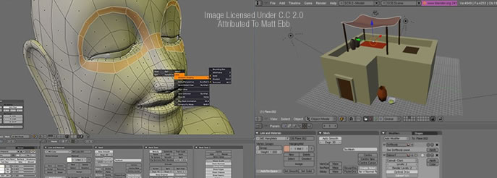
Animation & Simulation
Computer Animation
Computer Simulation

Slide 8
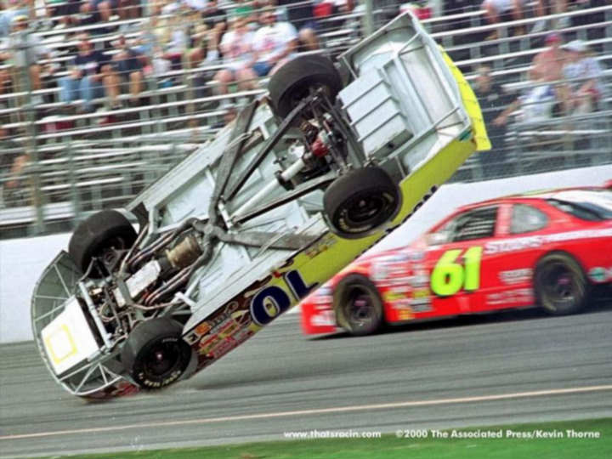
Animation - Advantages
Example: Race Car
Safer
No risk of crashing for driver
Cheaper
No running cost
e.g. petrol or new parts
Testing
Can be tested to see how it would cope in a crash situation

