Slide 1
The 3 P’s
Desktop Publishing.

Slide 2
The 3p’s
In your final assignment you will approach the theme just as a professional designer would, in the world of industry. This is tackled using the 3 P’s.
The 3 P’s are Preliminary, Production and Promotional.

Slide 3
Preliminary Graphics
The first of the P’s is the Preliminary Sketches usually carried out using
freehand. These sketches consist of various drawings including all planning
towards production and promotional drawings.

Slide 4
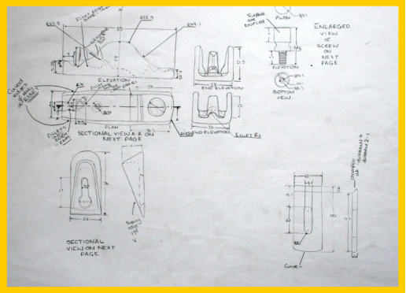
Preliminary Graphics
ORTHOGRAPHIC SKETCHES

Slide 5
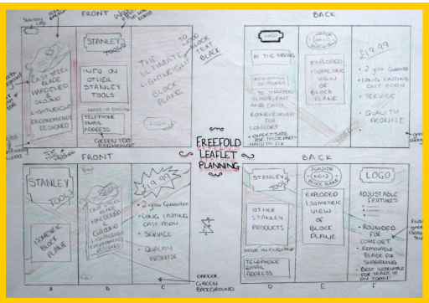
Preliminary Graphics
PLANNING PROMOTIONAL ITEM

Slide 6
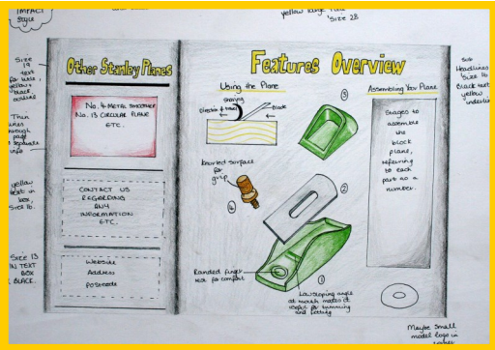
Preliminary Graphics
MANUAL 3 FOLD LEAFLET

Slide 7
Production Drawings
The second of the P’s is the Production Drawings which consist of all drawings enabling the manufacture of the product being designed. The drawings will be in the form of CAD drawings including orthographic, sectioned, exploded isometric, etc.

Slide 8
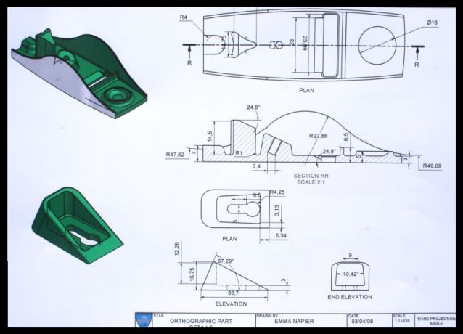
Production Drawings
Computer Aided Drawing (Section Orthographic)

Slide 9
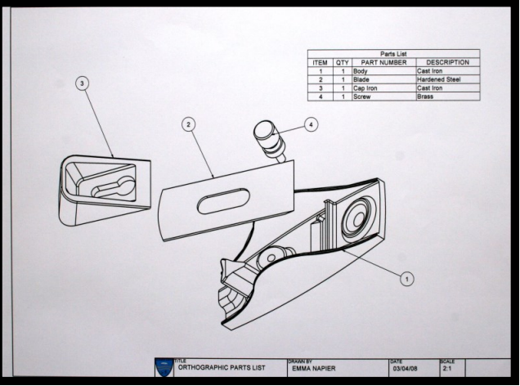
Production Drawings
Computer Aided Drawing (Exploded Isometric)

Slide 10
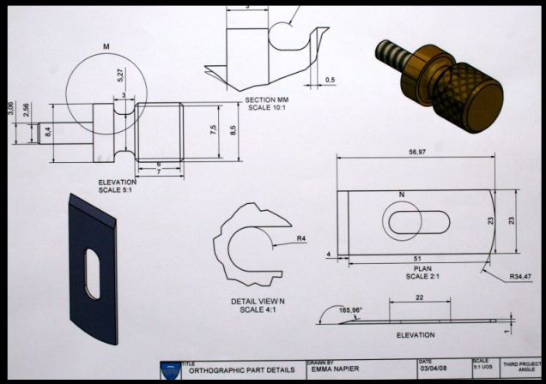
Production Drawings
CAD Detailed Orthographic

Slide 11
Promotional Graphics
The third of the P’s is the Promotional Graphics and consists of all CAG drawings which promote all aspects of the product being designed. This will include posters, fliers, booklets, etc.

Slide 12
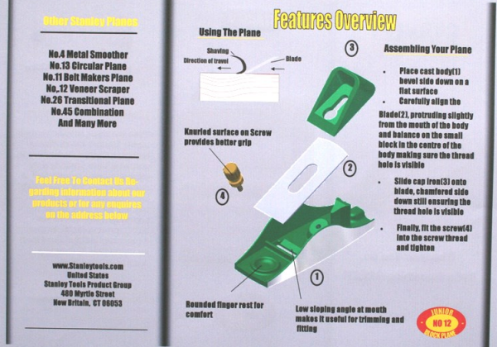
Promotional Graphics
Computer Aided Drawing (Section Orthographic)

Slide 13
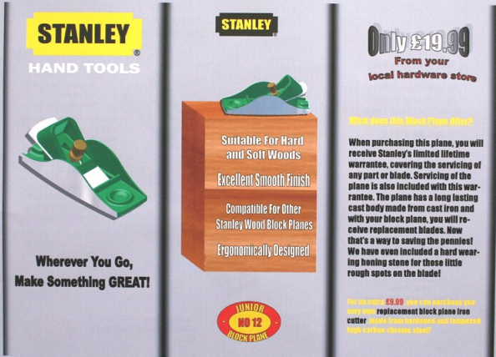
Promotional Graphics
Computer Aided Drawing (Exploded Isometric)

Slide 14
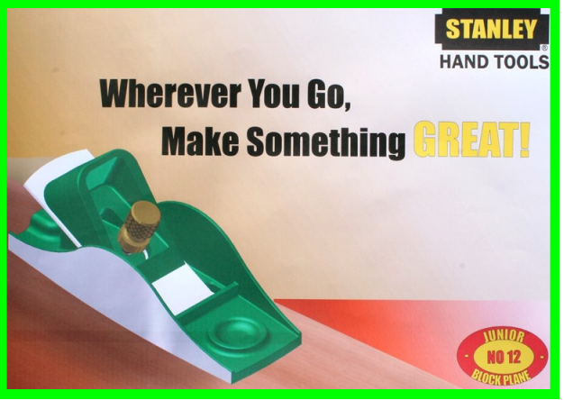
Promotional Graphics
CAD Detailed Orthographic

Slide 15
Environmental Issues
When creating DTP items graphic designers must consider how to distribute the information in an environmental way. At present we are wasting many resources with a frivolous lifestyle or culture, in order to reserve our planet. Ways in which this can be achieved are: •
Using recycled paper •
Publish online •
Use environmentally-friendly inks •
Print in regional offices to minimise carbon footprint of transportation •
Switch off computer

