Slide 1
Learning at home
How to get ready for your online school day

Slide 2
Using Teams
We will use Microsoft Teams whilst we are learning at home.
It is better to download the Teams app than use it through the web.
You will already be a member of the teams you need as they are the same as we have been using for homework. If you need a code to join these are all printed on the S1 timetable.
We have netbooks available for pupils to borrow. To do this use the link in the ‘Query’ section of the website page where you also find your S1 timetable.

Slide 3
The school day and your timetable
Your timetable will be different while you are learning online.
To get your new timetable go to our school website www.bathgateacademy@westlothian.org.uk
Click on “Coronavirus ongoing arrangements” and then “Remote learning arrangements from 11th January 2021.”
The S1 timetable is a download on the right of the page.
At the end of every week we publish on the website a ‘Learning overview for the week ahead” This lets you and your parents and carers see what you will be doing.

Slide 4
Your S1 timetable
Notes:
The first thing you will notice is that the school day looks slightly different. This is because we found this worked better than following the normal school day when we were in lockdown before.
We still start at 8:30am as usual and this time is for you to do some physical activity or make yourself a healthy breakfast. Eating well and exercising are really important for our mental health. You can get some healthy eating ideas by following the link in the Learning overview for the week ahead. For physical activity don’t forget PE with Joe Wicks is back Mondays, Wednesdays and Fridays. On a Wednesday at 9am S1 have their PSE lesson so join the team for that.
The first block of learning starts at 9:30am and lasts 90 minutes. There are three blocks for learning each day Monday to Thursday and 2 on a Friday.
When you join the team for the lesson a teacher for that subject will explain what you will be doing. It may not be the class teacher you usually have. That teacher will be able to help you if you need to ask them about anything. Our Support For Learning teachers are often also there during the lesson for help.

Slide 5
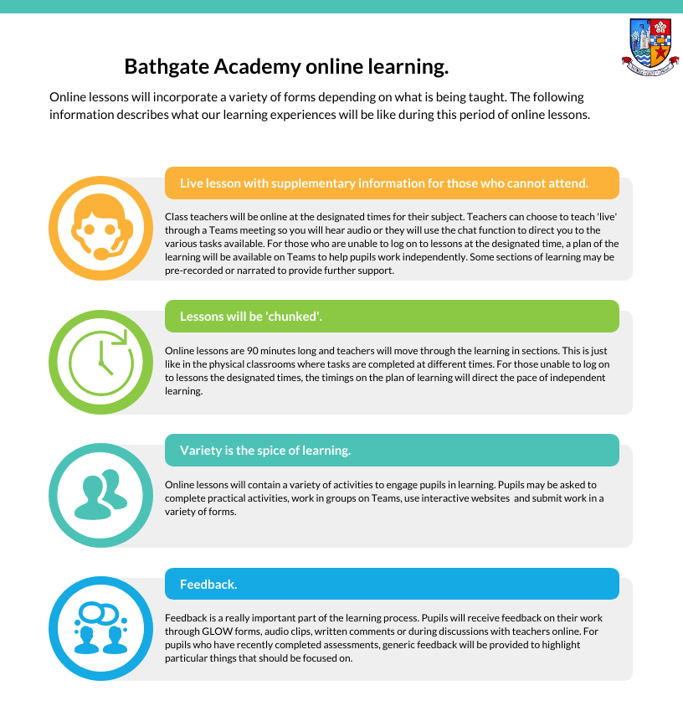
What will lessons be like?
Notes:
Class teachers will be online at the designated times for their subject. Teachers can choose to teach 'live' through a Teams meeting so you will hear them or they will use the chat function to direct you to the various tasks available. For those who are unable to log on to lessons at the designated time, a plan of the learning will be available on Teams to help pupils work independently. Some sections of learning may be pre-recorded or narrated to provide further support.
Online lessons are 90 minutes long and teachers will move through the learning in sections. This is just like in the physical classrooms where tasks are completed at different times. For those unable to log on to lessons the designated times, the timings on the plan of learning will direct the pace of independent learning.
Online lessons will contain a variety of activities to engage pupils in learning. Pupils may be asked to complete practical activities, work in groups on Teams, use interactive websites and submit work in a variety of forms.
Feedback is a really important part of the learning process. Pupils will receive feedback on their work through GLOW forms, audio clips, written comments or during discussions with teachers online. For pupils who have recently completed assessments, generic feedback will be provided to highlight particular things that should be focused on.

Slide 6
If you need help ……
You can message or speak to the teacher during the lesson.
You can also use the team for your House to message staff. Your House Leader, House PSA and House Support for Learning teacher are all on this team.

